Slide 2
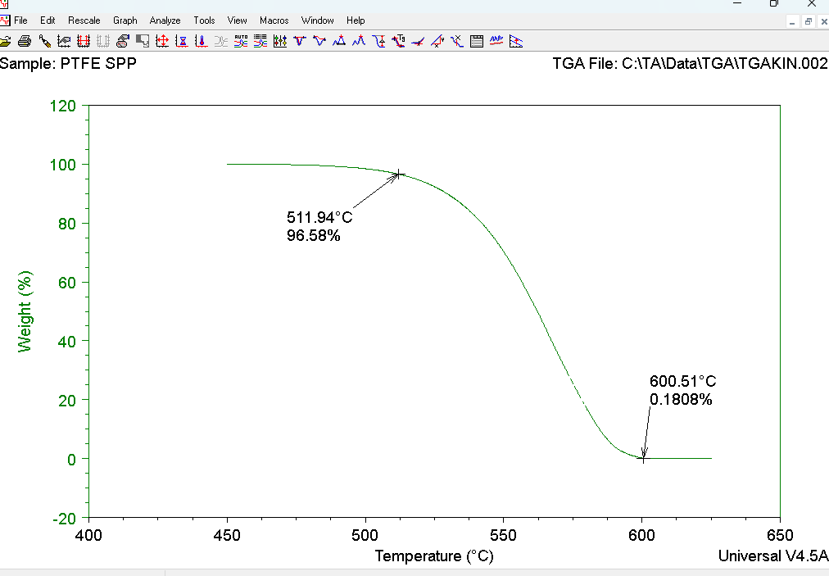
TGA Heat vs weight in percentage

Slide 3
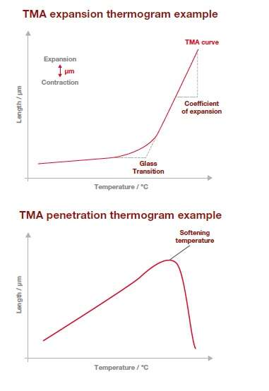

Slide 4
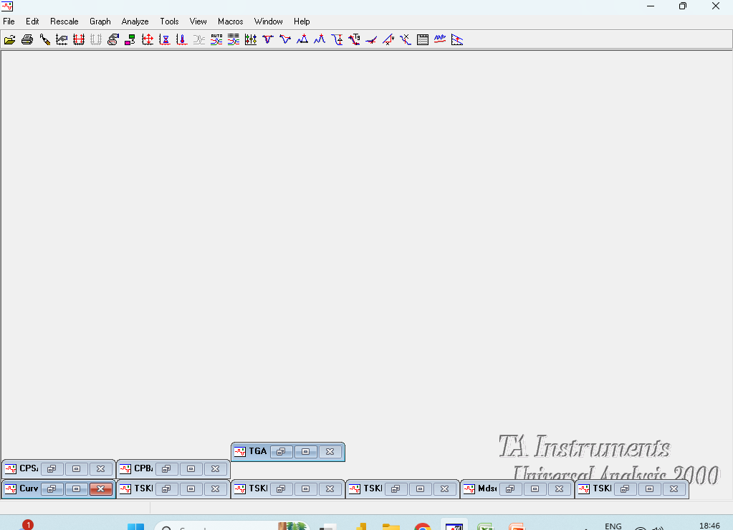
TA Universal Analysis tool

Slide 5
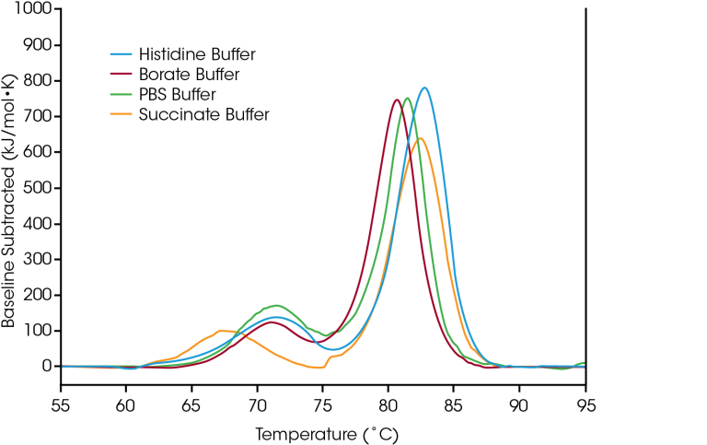
Baseline

Slide 6
TGA

Slide 7
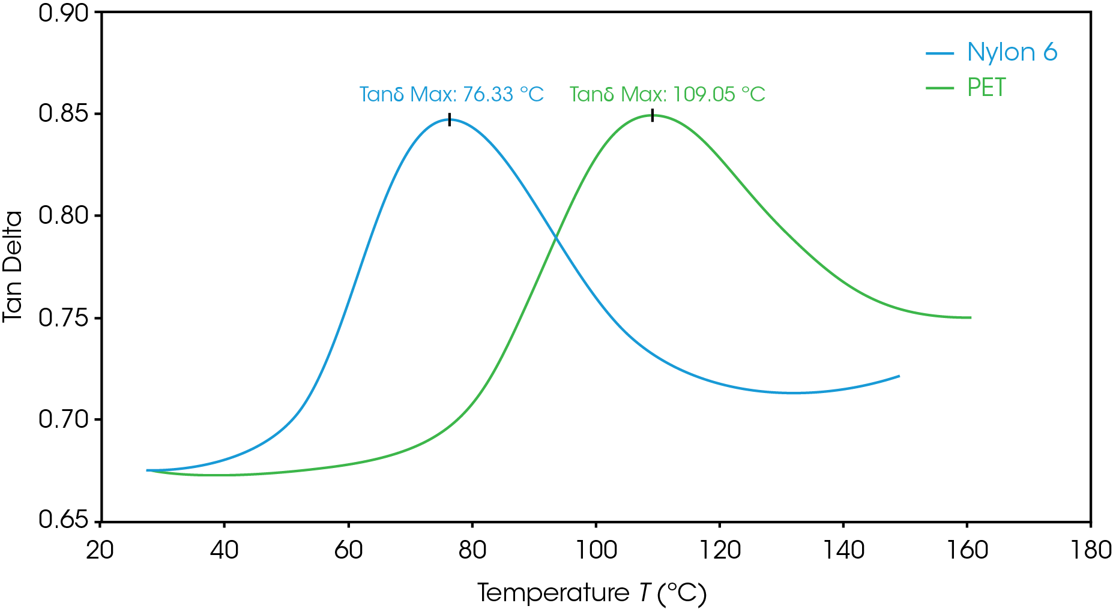
CTE By TGA

Slide 8
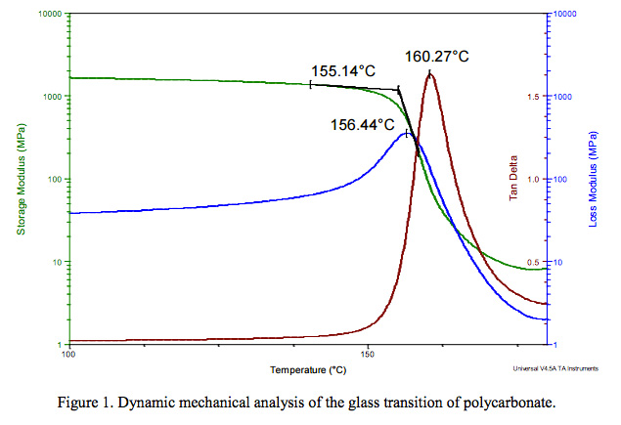
DMA Curve

